Slide 1
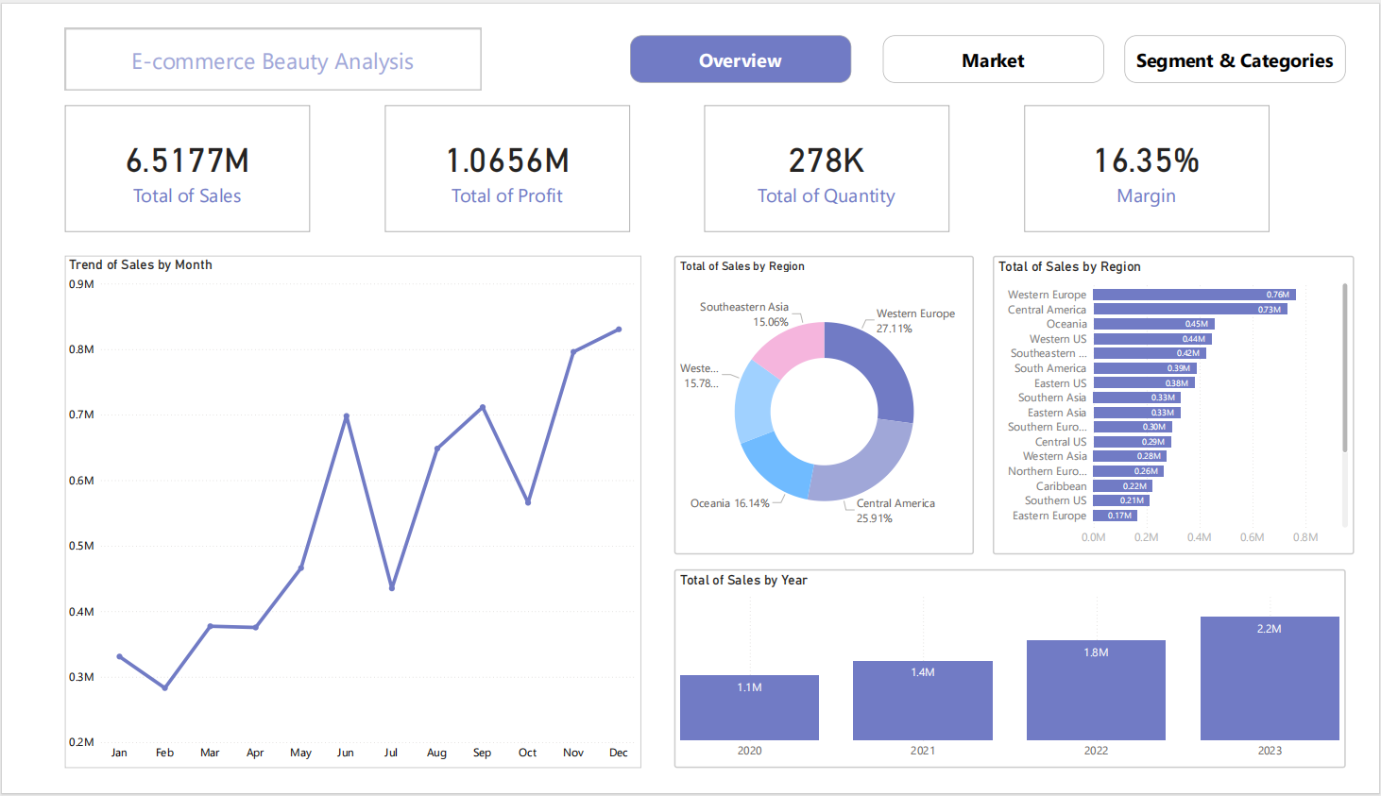
Notes:
Winter: December, January, February
Spring: March, April, May
Summer: Jun, July, August
Autumn: September, October, November

Slide 2
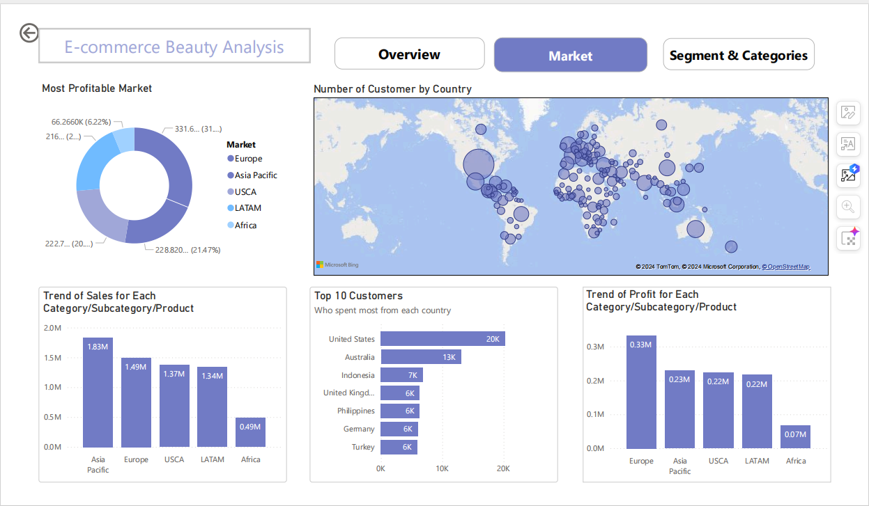

Slide 3
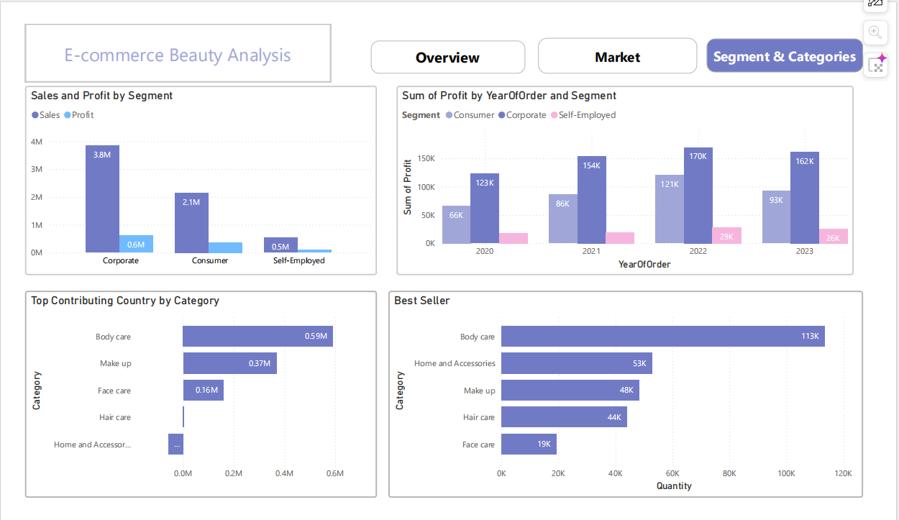

Slide 4
Overview Insights
The profit margin exceeded 10%, which is generally considered a strong margin for most businesses.
Sales trends showed significant spikes at the start of winter (December), summer (June), and autumn (August), followed by gradual declines. This pattern may be driven by seasonal changes, encouraging customers to update their beauty products.
Europe and America were the top regions in terms of sales.
E-commerce sales have shown consistent year-over-year growth, with sales volume steadily increasing annually

Slide 5
Market Insights
Europe and the Asia Pacific were the top markets in terms of profit.
The United States had the highest number of customers.
The top three markets by sales were Asia Pacific, Europe, and USCA.
Customers in the United States had the highest total spending.

Slide 6
Segment and Categories Insights
The corporate segment led in both sales and profit.
Following corporate in terms of profit was the consumer segment. Profit from consumer beauty products in e-commerce increased each year from 2020 to 2022, with a slight decrease in 2023.
Body care was the top category in terms of profit.
Body care also ranked first in quantity sold.

